Slide 1
Brain Integration for Success in Computer Science
Science and Technology of Consciousness for the Computer Professional
Frederick Travis, PhD
Dir, Brain, Consciousness, & Cognition Center
Maharishi University of Management, Fairfield, Iowa USA
Notes:
10:15 – 11:50

Slide 2
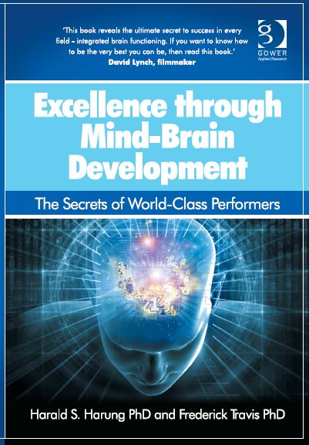
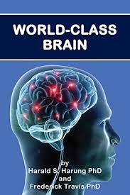
What explains performance levels?
Education 1 %
Work Experience 3%
Age 0%
Amount of practice
1% Professions
12% Music, Sports
Monetary incentives decrease job performance.
Schmidt & Hunter, 1998
Notes:
extensive meta-analysis up to 90 years shows that

Slide 3

Wholeness
Higher mind-brain development is the basis of higher performance in
any vocation
or activity.
For individuals
For organizations

Slide 4
Higher Mind/Brain Development
Individual
psychology
Level of
brain
integration
Frequency
of peak
experiences
Performer’s mind-brain development
Performance
Social context of performance

Slide 5


1. Brain Integration
Notes:
Before conductor come….we want conductor

Slide 6
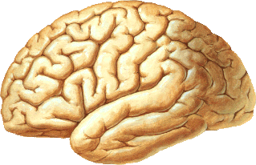
EEG COHERENCE
Low coherence
High coherence
Notes:
You get two EEG signals:
if you compare the first two, you can see they are not very similar. Let’s say they are 15% similar.
What about the other two signals? Obviously, they are identical. Their similarity is 100%, coherence is 100%.
(if you are talking to laypersons, it is better to be short, and ignore the difference between synchrony and coherence!)
Otherwise you briefly explain the difference.)

Slide 7
Oxford University study: Connectivity (MRI)
Low connectivity
High connectivity
Anger
Rule-breaking
Substance use
Poor sleep quality
Vocabulary
Memory
Life satisfaction
Income
Smith et al., 2015

Slide 8
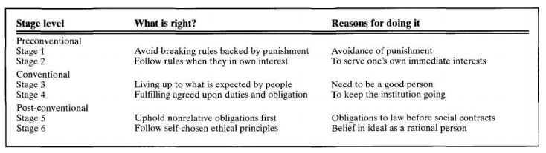
2. Psychological development: Moral reasoning

Slide 9
Nursing Performance
Latiff and Berger, 1999

Slide 10
What is the role of moral reasoning in computer programming?

Slide 11

3. Peak experiences: “Most happy and fulfilling moments in life...
When I have this extreme alertness, the body reacts automatically – everything goes by itself. It goes by intuition.
... as if my inner reality expands to include the activity of the whole orchestra and even the audience.
It is difficult to describe, but it feels like experiencing a kind of eternity, contrary to everyday life, which is in continuous motion.

Slide 12
Peak Experience (zone)
“Navigation was easy and running was effortless and joyful. As the race progressed, I felt increasing exhilaration and energy. During the last uphill before the finish, I felt as if I was floating. I was alert, but restful at the same time. And I won first place overall.”
Dr. Harung

Slide 13
Discuss in Small Groups
Have you had an experience similar to what Dr. Harung describes of being in the zone?
How did that experience affect you?

Slide 14
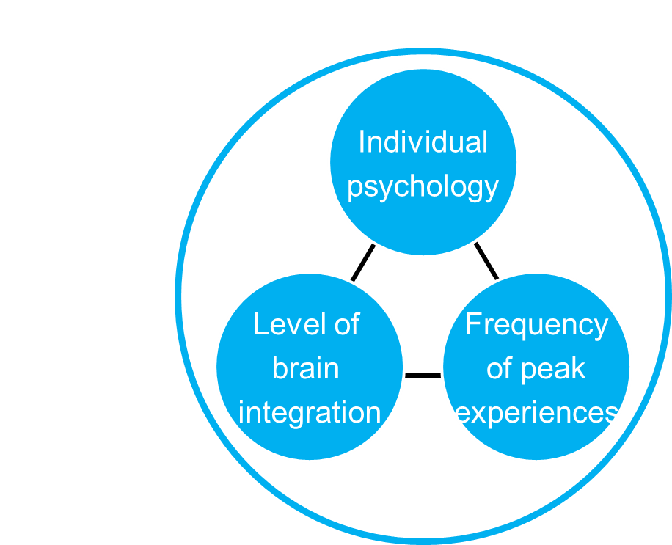
Meditation is a means to enhance all three factors of mind/brain development

Slide 15

EEG demo: Let’s look under the hood
(Take a 7 minute break while I put on the sensors.)

Slide 16



Meditations explore the structure of conscious experience
Subject
Process
Object
Knower
Knowing
Known

Slide 17
What stands out in the description of this meditation?
While meditating, all thoughts vanished. Eyelids remained half-open. Attention began to focus just on the in-and-out breathing movements down in the lower abdomen. Suddenly, enhanced attention came to a very sharp point of focus, held on by just the simple, physical up-and-down rhythm of each breathing movement itself. No sense remained of the rest of my body nor anything in the environment.

Slide 18

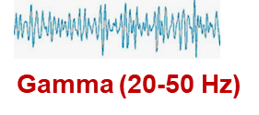
Vipassana probes the object…
Object
Zen
Compassion Meditation
Vipassana
Qigong
Known

Slide 19
What stands out in the description of this meditation?
I focused solely on the respiration, not to control it. I observe my breath at the point where it enters and exits the nostrils. This focus proves an almost laughable struggle mentally and physically. As I do this, my mind becomes a flipbook of memories. I turn page by page from present to the past as far back as pre-kindergarten. I find I’m re-processing who I am.

Slide 20

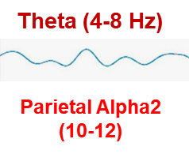
Mindfulness probes the link…
Process
Mindfulness
ZaZen
Non-directed Meditation
Saharaj Yoga
Knowing

Slide 21
What stands out in the description of this meditation?
Immediately as I start to meditate, thoughts become more secondary in experience and an underlying pervasive inner silence becomes more primary. Many times during meditation practice all mental activity settles to silence. I am completely whole and at peace.

Slide 22

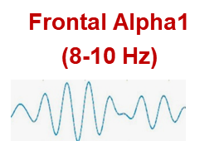
Transcendental Meditation probes the subject…
Subject
Transcendental Meditation
Qigong master (45 years)
Zen-Buddhist priests (25 years)
Knower
Travis and Shear, 2010

Slide 23

Categories of Meditation
Focused Attention
New ways to use your mind
Focus (Gamma 30-50 Hz)
Open Monitoring
Mindful (Theta 5-8 Hz)
Automatic Self-Transcending
Sharpens your mind
Transcend (Alpha1 8-10 Hz)
Travis and Shear, 2010
Notes:
23
NDA meditations could be seen as
23

Slide 24
What does “Sharpens your mind” mean?

Slide 25
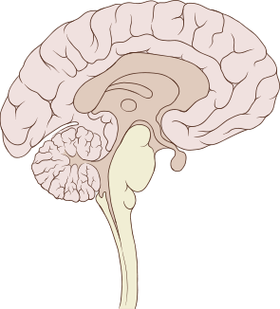
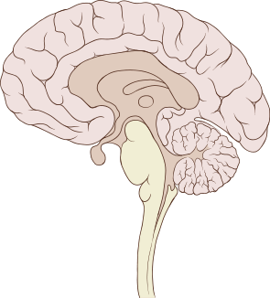
Rest
Sharpens your mind means higher frontal blood flow
Restful Alertness during TM Practice
Stress
Mahone et al, 2017

Slide 26
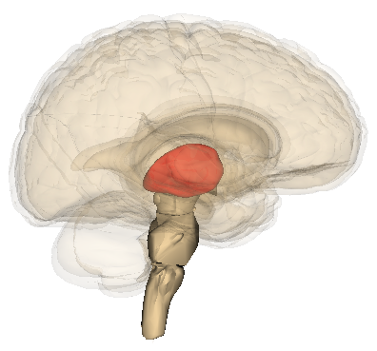
“Sharpens your mind” means being more awake
Wakefulness
Content
Travis, 2012
Notes:
Thalamocortical core nuclei project to brain regions involved in representing sensory input and externally-directed attentions;
thalamocortical matrix nuclei project to brain regions involved in self- awareness, introspective thinking and modulate generalized wakefulness or alertness of the other cortical layers.

Slide 27
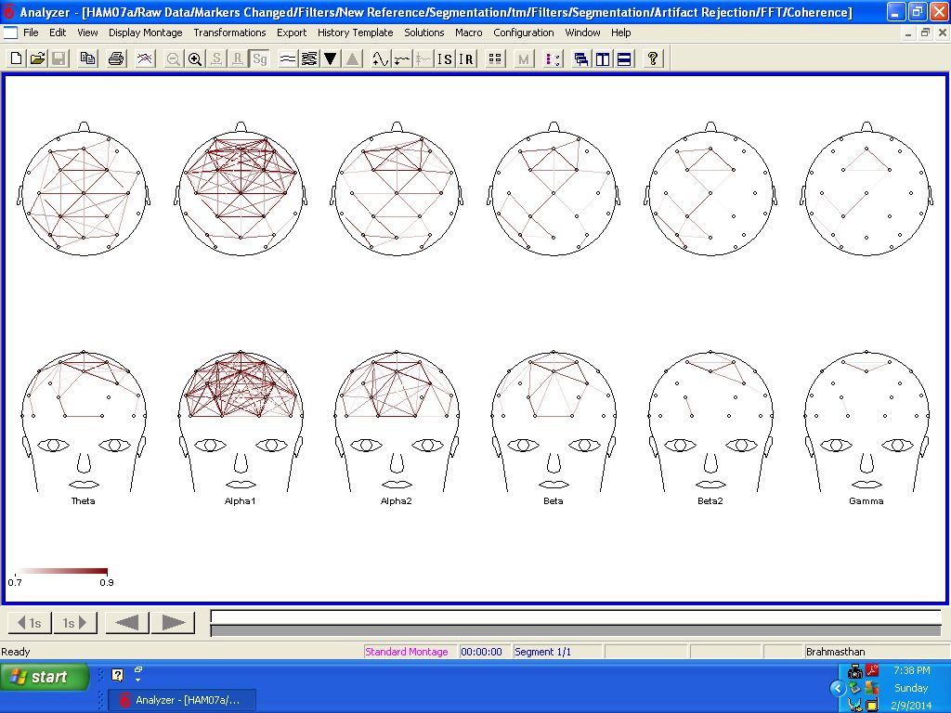
“Sharpens your mind” means higher alpha1 coherence during TM practice

Slide 28
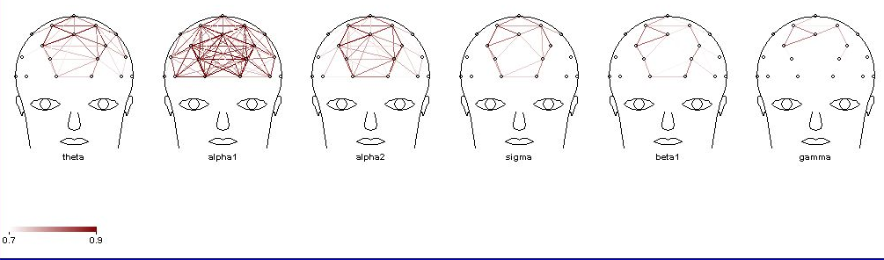
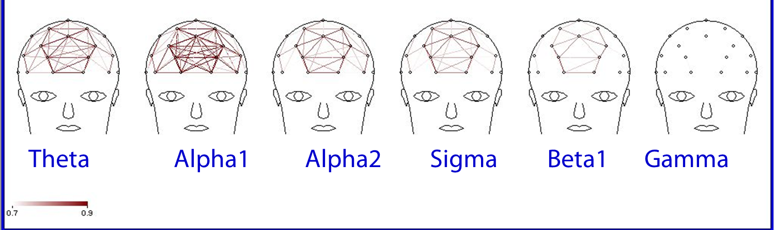
…and this coherence happens quickly during Transcendental Meditation!
6 months TM practice
24 years TM practice
Notes:
6-month top Purusha bottom

Slide 29
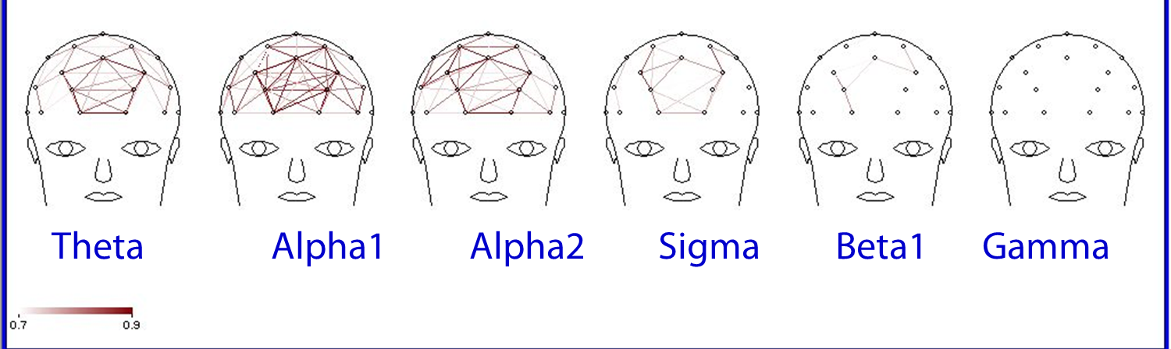
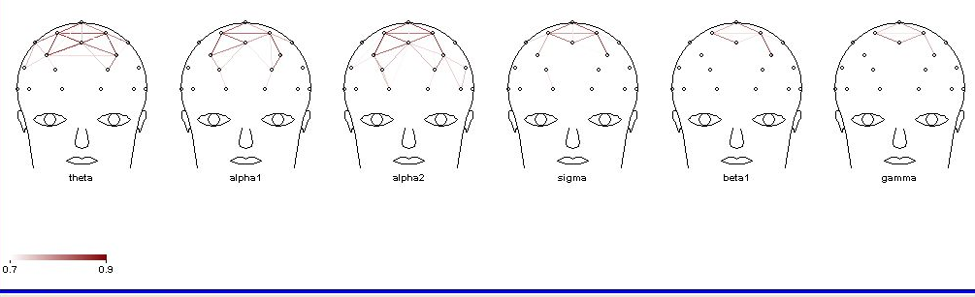
“Sharpens your mind” means higher alpha1 coherence during the day
24 years TM practice
6 months TM practice
Notes:
6-month top Purusha bottom

Slide 30
“Sharpens your mind” means Lower Anxiety Meta-Analysis
TM
Placebo
Other Relaxation
Relaxation Response
Other Meditation
PMR
EMG-Biofeedback
Mantra Meditation
Concentration
0
.5
1
Eppley et al. 1989; Orme-Johnson and Barnes, 2017

Slide 31
“Sharpening your mind” means reduced teacher burnout
Mean Change
Elder et al, (2014)
Notes:
TM is not only great for the students, but also reduces teacher burnout.
A randomized controlled study of secondary school teachers in Vermont found that TM practice significantly reduced depression, perceived stress, and overall teacher burnout. (Elder et al. 2014)
Charles Elder, Center for Health Research in Portland, OR.
Sanford Nidich, EdD, Maharishi University of Management
Francis Moriarty, EdD, Mountain Valley Treatment Center in Pike, New Hampshire
Randi Nidich, EdD, Maharishi University of Management in Fairfield
Elder, Charles , Sanford Nidich, Francis Moriarty, and Randi Nidich. "Effect of Transcendental Meditation on Employee Stress, Depression, and Burnout: A Randomized Controlled Study." The Permanente Journal 18, no. 1 (2014): 19-23.
A study in progress found Transcendental Meditation improves leadership excellence. Vernon Barnes, Ph.D.

Slide 32
Questions?

Slide 33
Harung et al, 2011, Harung and Travis, 2012, Travis et al, 2011, Travis et al 2002
Notes:
Stability under pressure Decision making under pressure
"Mental toughness" and "resilience" (these are terms used commonly in the sports world)

Slide 34
Write, pair and share
What have you notice change in your life since you started Transcendental Meditation practice?

Slide 35
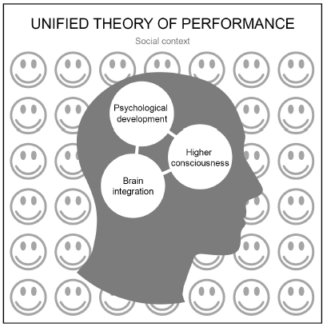
Conclusion
Transcendental Meditation is a means to develop all three elements of mind-brain development and so gives you an edge for success in computer science.

Slide 36

Any questions?
ftravis@mum.edu

